Slide 1
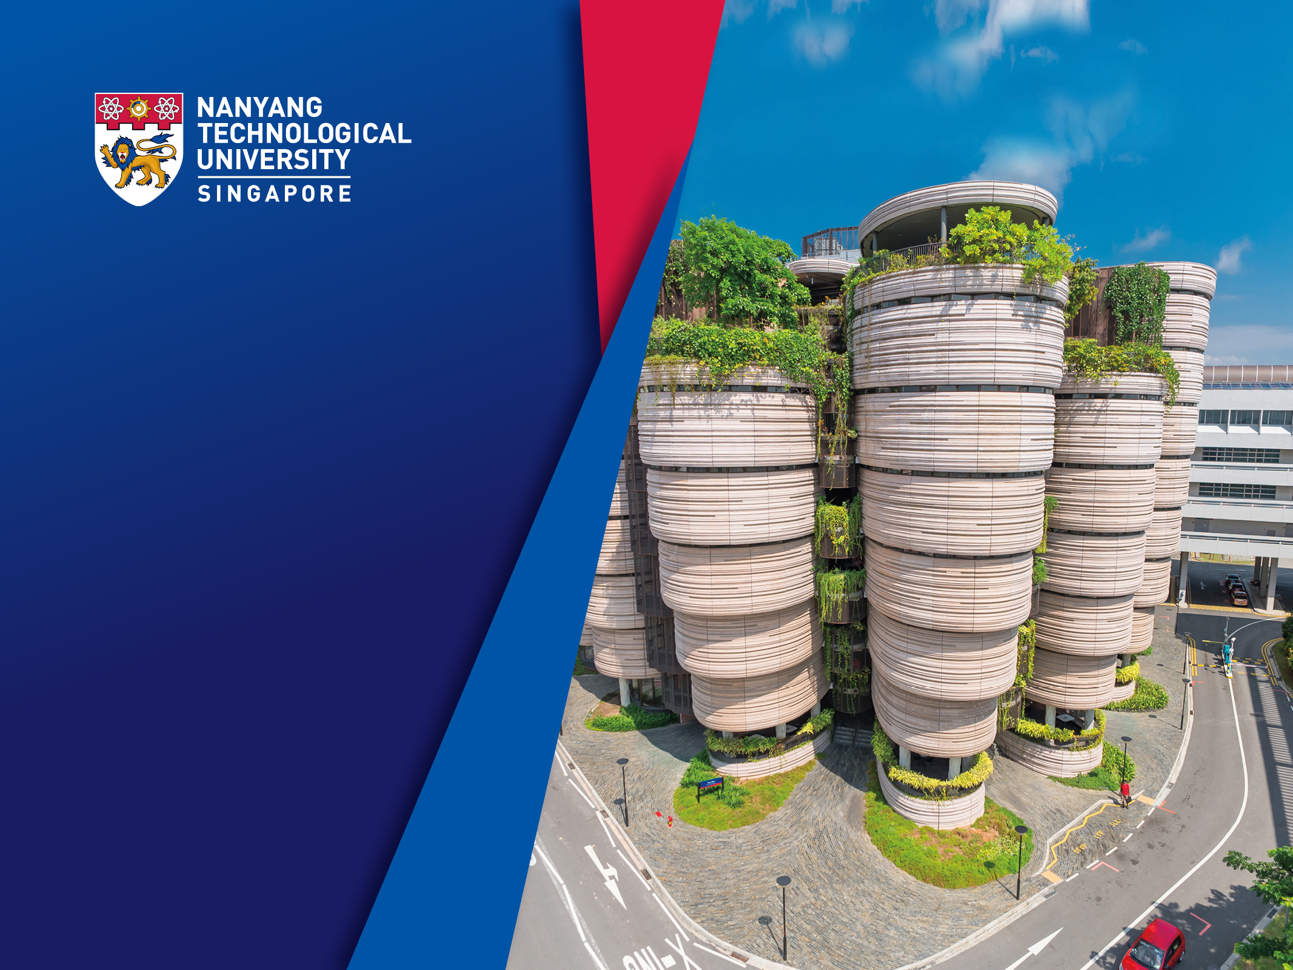
BC3409 AI in Accounting and Finance Lecture 1: Introduction to AI
Teoh Teik Toe
ITOM/NBS
ttteoh@ntu.edu.sg
Aug 2020
97905202

Slide 2
Polling Questions
PollEv.com/teikteoh614
AI Library Link: https://www.dropbox.com/sh/qi7lg59s3cal94q/AABJlbcC0OmApuhtpWa6K873a?dl=0

Slide 3
13 Commonly Asked Questions on Artificial Intelligence (AI)
1. What is the definition of artificial intelligence?
2. Who coined the term artificial intelligence?
3. Does artificial intelligence exist?
4. AI terminology – What are the most common AI terms you should know?
5. Can artificial intelligence be dangerous?
6. How will artificial intelligence change the future?
7. Why do we need artificial intelligence?
8. Why should you study artificial intelligence?
9. How can we apply artificial intelligence?
10. What are the typical jobs related to artificial intelligence?
11. Will China be the AI super power?
12. Which are the most powerful artificial intelligence companies?
13. What are some common benefits of artificial intelligence technology?
https://www.lasserouhiainen.com/7-questions-artificial-intelligence/

Slide 4
Objective of this class
Intro to BC3409
Intro to AI
AI Models
AI Tools
Library:
https://www.dropbox.com/sh/qi7lg59s3cal94q/AABJlbcC0OmApuhtpWa6K873a?dl=0

Slide 5
Class Plan
1hour online
Lecture + Practical (1hours 15mins)
15mins break
Lecture + Practical (1hours)
Presentation and Discussion (0.5 hours)

Slide 6
BC3409 AI in Accounting and Finance

Slide 7
Weekly Plan
Introduction to AI & Installing Python and R
Neural Network 1 (PA)
Neural Network 2 (PA)
Weka (PA & Project)
Chatbot 1 (Project)
Chatbot 2 (Project)
RPA 1 (Project)
RPA 2 (Project)
Practical Assessment Review
Project Review
Block Chain (Project)
Deep Learning – Tensor Flow LSTM GAN & Reinforcement Learning
Project Presentation

Slide 8
Video Recording
Regression (PA) – Video : https://www.dropbox.com/sh/dcz4m1ps91mimzz/AACBicbA3-KABogiJ3iWu5N9a?dl=0
Decision Tree (PA) – Video: https://www.dropbox.com/sh/lsjq0p395b9v3hz/AAC5N_k1s4gX-2m4xdjJ25Tka?dl=0
Text Analytics – Video : https://www.dropbox.com/sh/h5j15ofjyz474cs/AADjDlUhUO4cutjCCqxvY3mLa?dl=0

Slide 9
Objective of this class – Domain Knowledge
Financial Management
Management Accounting
Financial Accounting

Slide 10
Objective of this class – Domain Knowledge
Analytics
Prediction
Automation

Slide 11
Objective of this class – Skill Knowledge
Neural Network
Chatbot
RPA

Slide 12
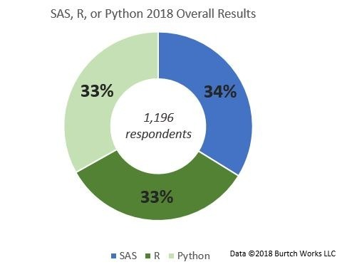
Programming Language and Tools: Python, R and Weka

Slide 13
Consultation
S3 B2 C110
65148988/97905202/ttteoh@ntu.edu.sg
Wednesday 130pm to 330pm
Optional (by Appointment)
Tuesday 11am to 1pm
Thursday 11am to 1pm
Or any other timing

Slide 14
Assessment
Component | Weightage | Team/Individual
Class Participation | 15 | Individual | Week 1 to 13
Practical Assessment | 40 | Individual | Week 10
Individual Project | 30 | Individual | Week 11 (Video Clip)
Group Project & Presentation | 15 | Team | Week 13 (Video Clip & 15 mins Presentation for each group)
Total | 100%

Slide 15
Mark Distribution and Deadline
Participation 15%
Discussion
Chatbot Presentation (Week 7)
RPA Presentation (Week 9)
Individual Project 30%
Individual Project Plan 5% (Week 5)
Final Report 25% (Week 12)
Group Project 15%
Group Project Plan 5% (Week 6)
Final Report 10% (Week 13)
Practical Assessment 40% (Week 10)

Slide 16
Individual and Group Project
Prediction
Analytics
Dashboard
Chatbot
RPA
Data source:
Kaggle
Or https://www.dropbox.com/sh/2gusfymynty76wn/AACRo7xXjwHYR9f3bRlUG9gda?dl=0
Sample
https://www.dropbox.com/sh/4npxwpy2y5a8g68/AACvkV8Yo4dU9NnvCxN9ppcga?dl=0

Slide 17
Individual/Group Project
Refer to Individual/Group Project Document for Detail
Sample: https://www.dropbox.com/sh/4npxwpy2y5a8g68/AACvkV8Yo4dU9NnvCxN9ppcga?dl=0

Slide 18
Individual/Group Project
Chinsay (Hilary) - Dashboard and Analytics https://www.chinsay.com/
Luye (Manaen)﻿ - Hospital Operation Analytics https://www.luye.cn/lvye_en/
Kaggle competition: https://www.kaggle.com/competitions
https://www.kaggle.com/c/competitive-data-science-predict-future-sales
https://www.kaggle.com/c/nlp-getting-started
Or any competition.
Both Chinsay and Luye will come to our class to explain to you what their project is about (15mins each). I will let you know the time.

Slide 19
Practical Assessment
You will be given a set of data
You have one week to complete
You should use neural network (regression and decision tree is optional)
Sample: https://www.dropbox.com/sh/bnlk9jz8ximdqxk/AABmvkX8rWCcFyloXmZ1CRgra?dl=0
https://www.dropbox.com/sh/ygdfp3n3rlb5m54/AABO8Wyd7Y9F_VA0zeTKwgGSa?dl=0
Overall library : https://www.dropbox.com/sh/ygdfp3n3rlb5m54/AABO8Wyd7Y9F_VA0zeTKwgGSa?dl=0

Slide 20
Project
Project Deliverables:
A concise report in ppt or word document format, with a one to two page executive summary, of your most important findings. Guideline: Approximately 20 pages, excluding appendices and executive summary.
The R/Python or other programming script used to execute the analytics. Also provide the screenshots of the software and settings used. Show enough such that another independent group of researchers can reproduce and verify your findings.
Please attached the data used (.csv).

Slide 21
Intro to AI

Slide 22
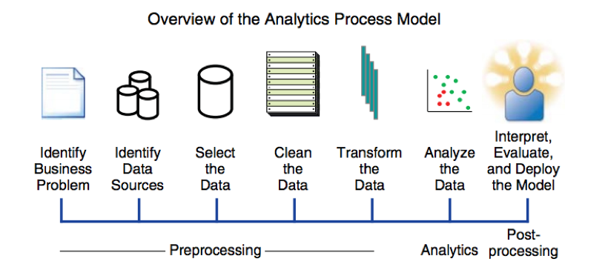
https://images.app.goo.gl/umxF2iK8fQFKj6Wm9

Slide 23
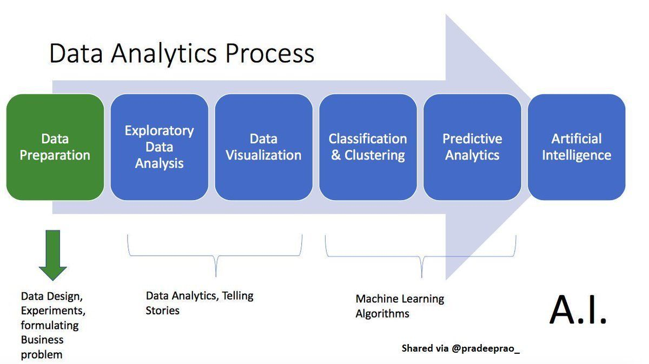
https://images.app.goo.gl/LgC1PvxDR9EDxBD97

Slide 24
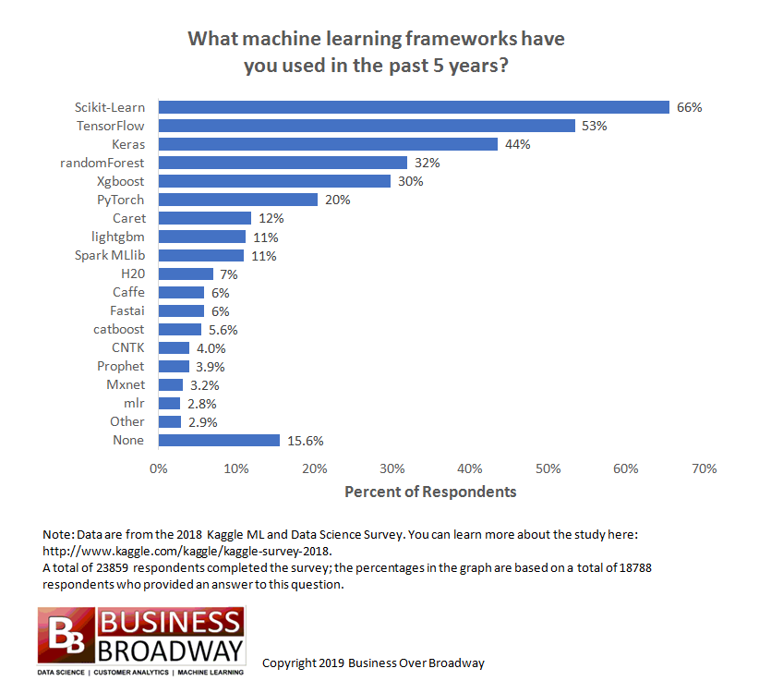

Slide 25
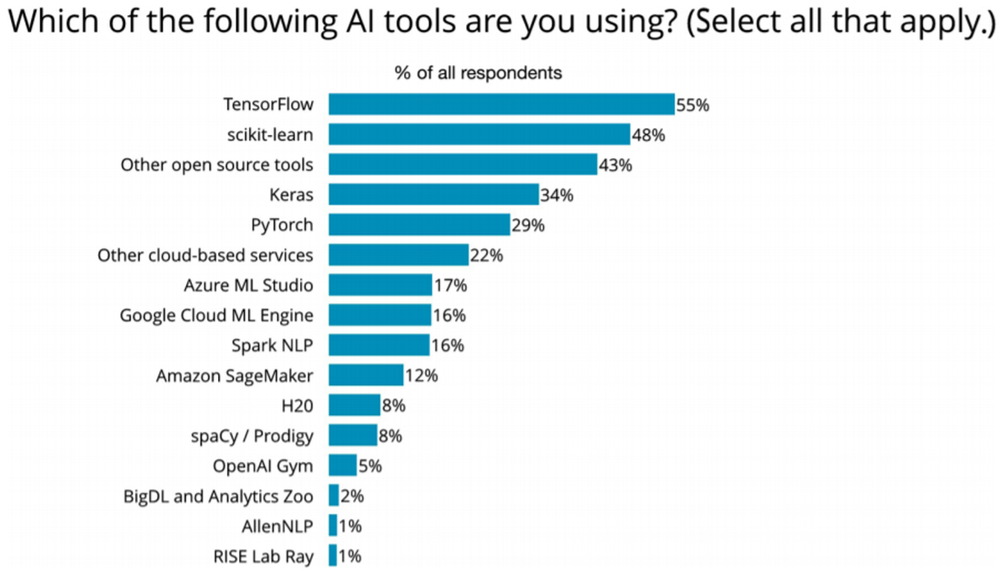
https://www.techrepublic.com/article/most-popular-programming-language-frameworks-and-tools-for-machine-learning/

Slide 26
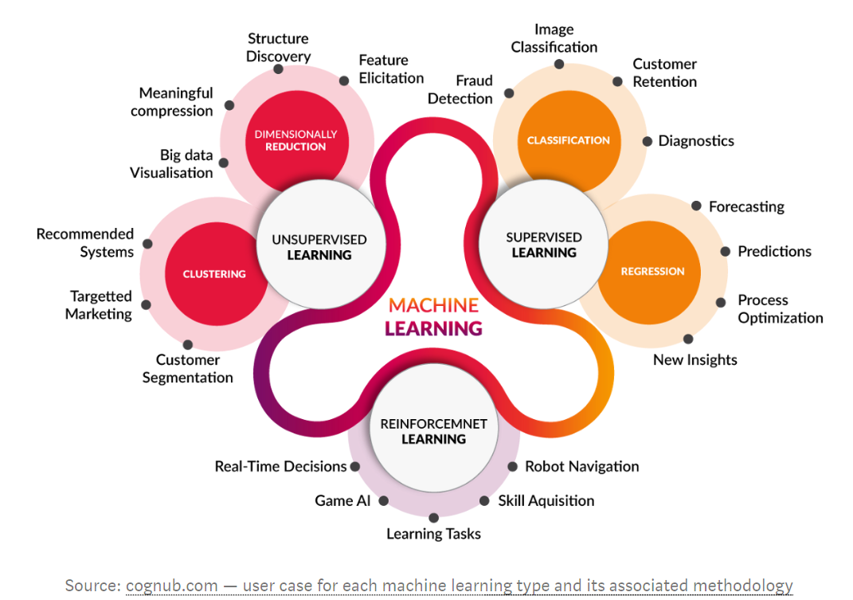

Slide 27
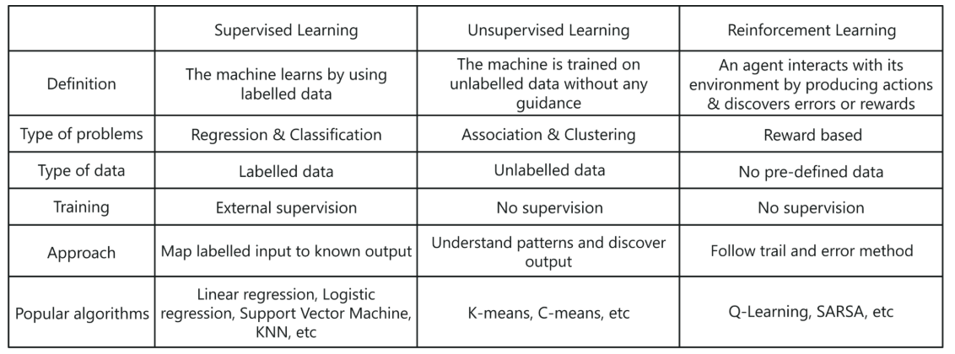
Types of AI/ML

Slide 28
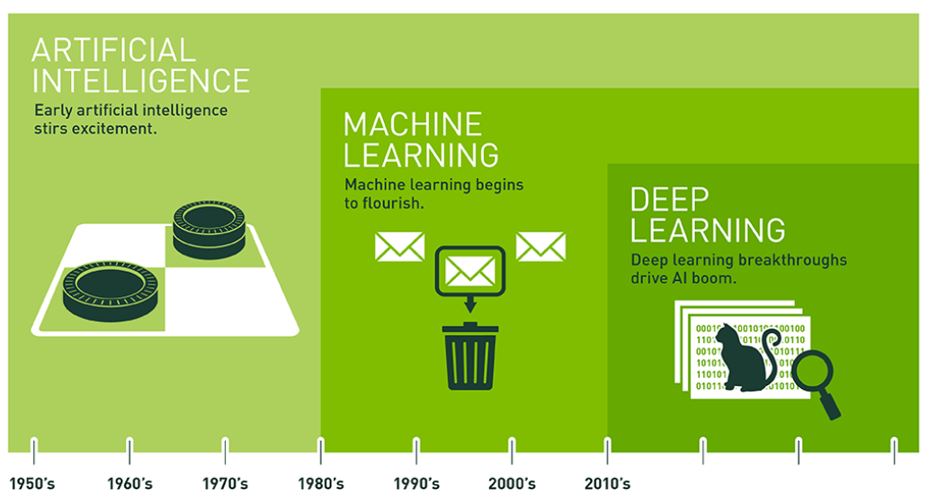
https://blogs.nvidia.com/blog/2016/07/29/whats-difference-artificial-intelligence-machine-learning-deep-learning-ai/

Slide 29
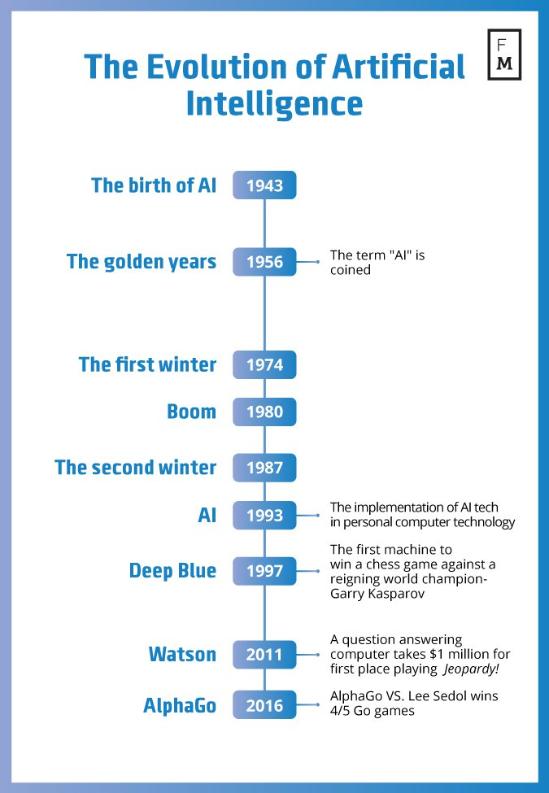
Evolution in AI
Source: https://davidlecea.wordpress.com/2016/11/10/robots-on-the-rise-how-ai-can-change-the-financial-world/

Slide 30
AI and Big Data
AI and Big Data
Internet of Thing
Robotic Process Engineering
Block Chain
Cloud
Natural Language Processing

Slide 31
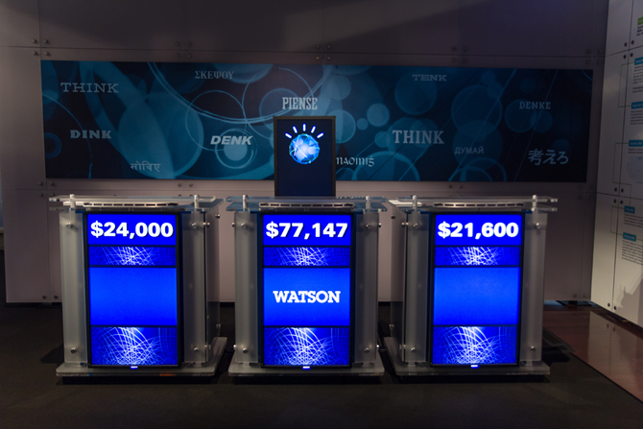
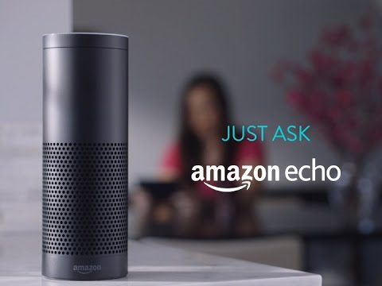
AI
AI : Machine to imitate intelligent human behavior
Popular AI Machine : IBM Watson, Apple Siri, Amazon Echo, Alpha Zero, Xiao Du
Source: https://sanvada.com/2018/01/27/ibm-believes-artificial-intelligence-will-change-world/
Source: https://tecake.in/amazon-echo-will-now-read-twitter-trends-alexa-assistant-updated

Slide 32
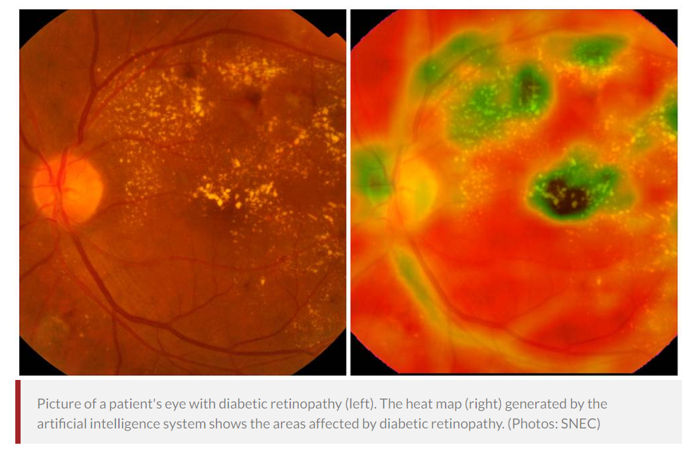
Singapore AI: Detect Eye Conditions
In a world first, Singapore-developed artificial intelligence system detects 3 major eye conditions
Singapore National Eye Centre (SNEC), Singapore Eye Research Institute (SERI) and National University of Singapore (NUS) School of Computing.
5 million images next 5 years
30 co-investigators
500,000 retinal images
180,000 out of 600,000 Singaporeans with diabetes have diabetic retinopathy – lead to blindness.
https://www.channelnewsasia.com/news/singapore/in-a-world-first-singapore-developed-artificial-intelligence-9498742

Slide 33
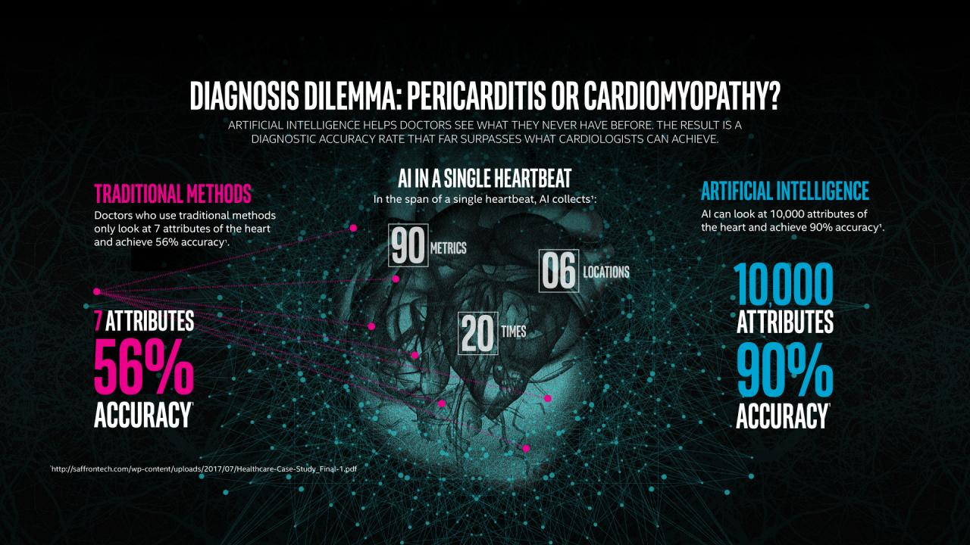
Cardiologist vs AI
Source: https://www.intel.com/content/www/us/en/healthcare-it/article/improved-diagnosis.html

Slide 34
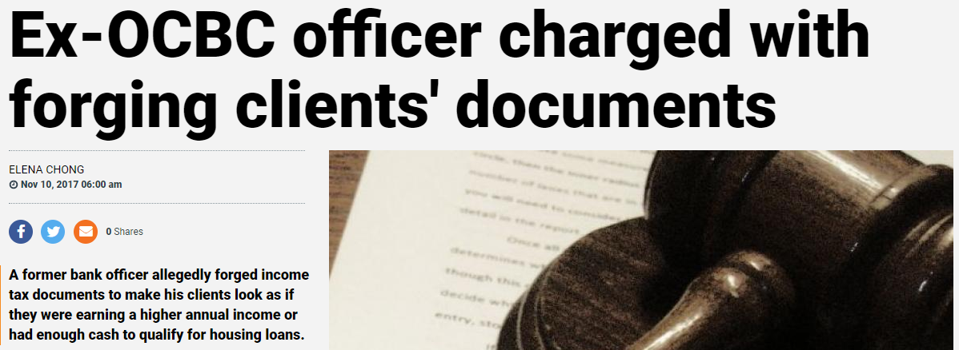
Data for banks: Security
Fraud Detection
Providing security is critical for both employees and customers.
With the scale of number of transactions, banks need to use Machine Learning as a proactive approach to security.
The key steps to fraud detection could include:
Data samplings for model estimation and preliminary testing
Model estimation
Testing
Source: https://www.tnp.sg/news/singapore/ex-ocbc-officer-charged-forging-clients-documents

Slide 35

Data for banks: Planning
Risk Modeling
Better cash/liquidity planning
How do you price your financial instruments? Through big data, banks can evaluate multiple streams of data sets and with a team of data scientists, develop risk modelling to employ a data-driven approach to pricing and risks.
You can track past usage patterns, daily coordination between in-and-out payments at branches and ATMs.
Predictive Analytics can be used to predict future needs of potential customers – leading to optimal management of the liquid assets.

Slide 36

Data for banks: Customers
Personalised Marketing
Seasoned marketers know this, personalised marketing based on the customer’s needs and preference can reap big rewards.
Analytics can help marketers in banks create customised offers, products to the right person, at the right time and even the right place.
Data mining is used to help choose the right potential group for new products.
Data scientists can use behavioral, demographic, and historical purchase data to build a model that predicts the response to a campaign or product.

Slide 37
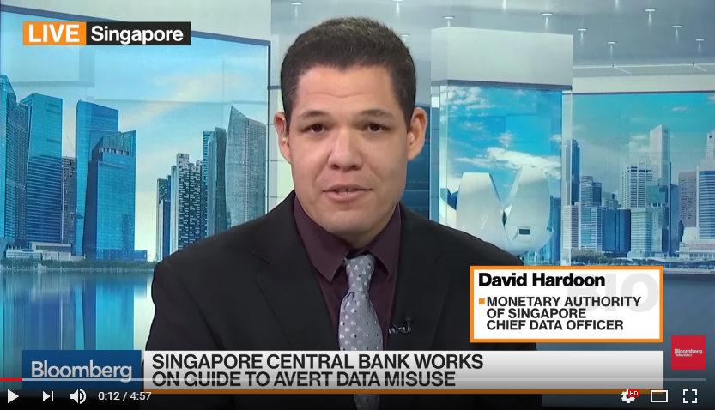
AI in Banking: Singapore
How AI, Data Analytics Will Fundamentally Transform Financial Industry
Source: https://www.youtube.com/watch?v=vhWMz0jOQi8

Slide 38
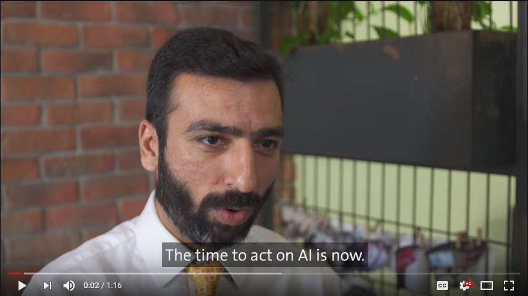
AI in Banking: Singapore
OCBC Bank launches its own artificial intelligence (AI) unit
Source: https://www.youtube.com/watch?v=eA78W8-dRlY

Slide 39
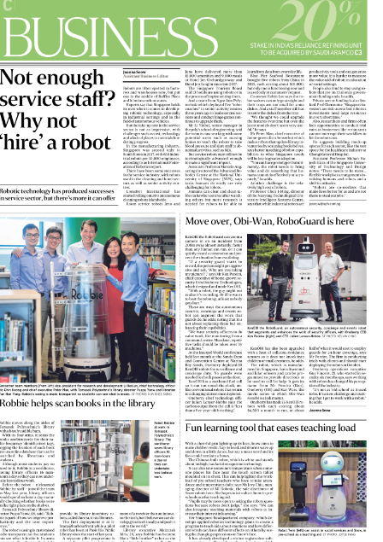
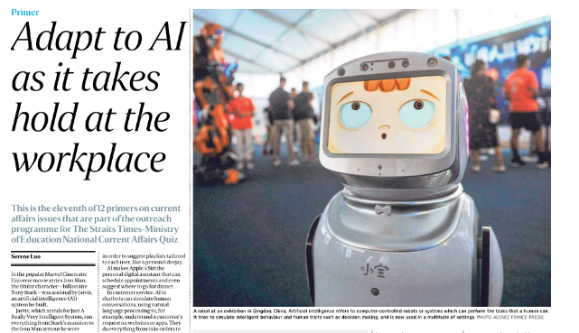
Why not hire a robot? Straits Times - 13 Aug 2019 Teachers Librarian Security Guard

Slide 40
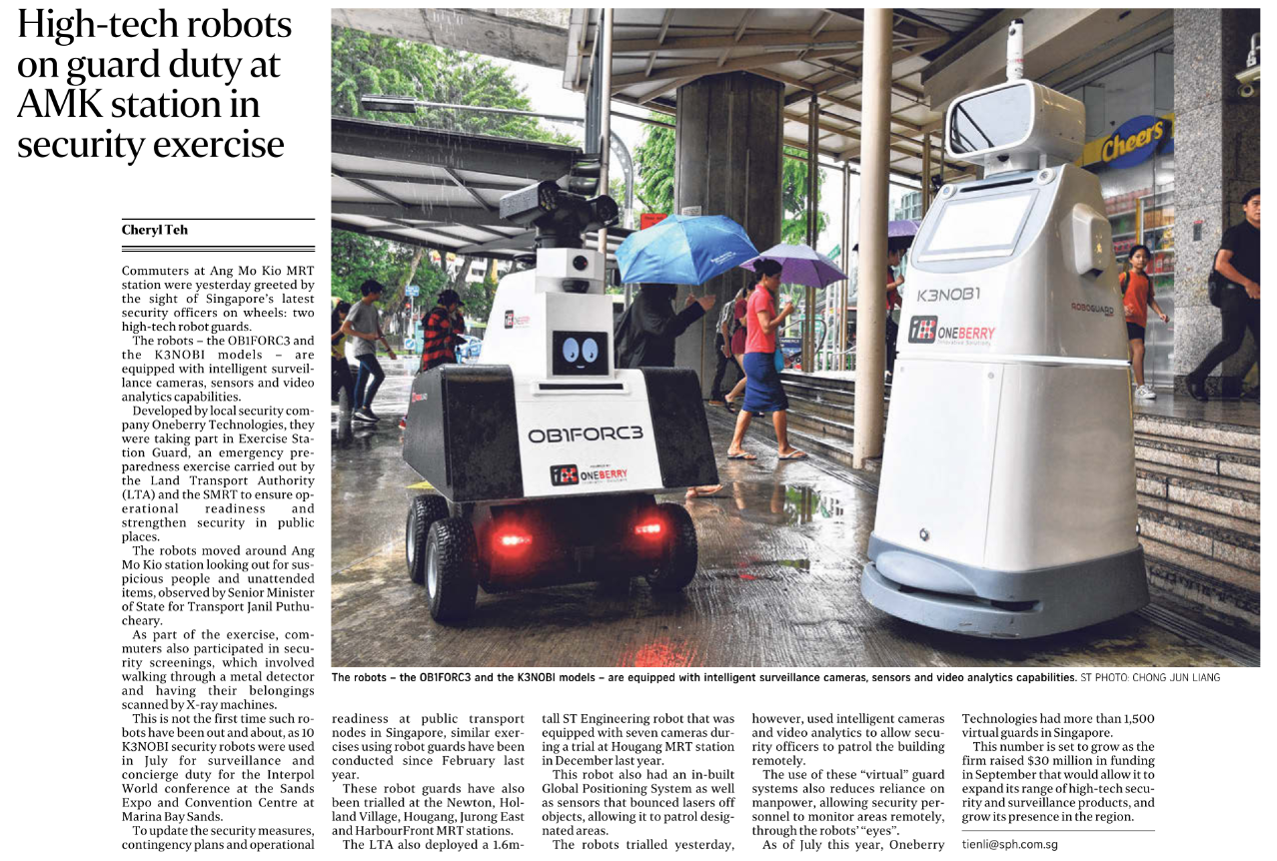
Dec 2019

Slide 41
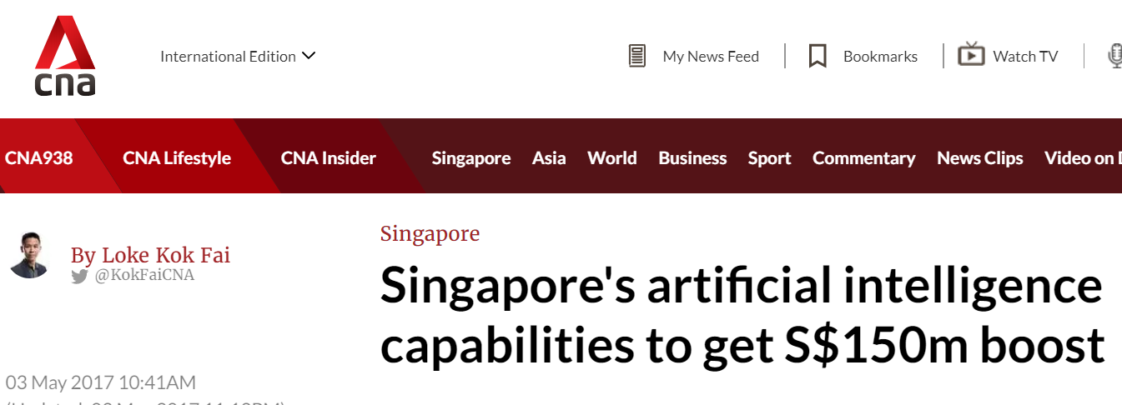
National Research Foundation (PMO): S$150million in AISG (May 2017)
https://www.nrf.gov.sg/programmes/artificial-intelligence-r-d-programme

Slide 42
Brains and Computers
Brain
200 billion neurons, 32 trillion synapses
Processing speed: 100 Hz
Parallel
Inputs are approximately summed
Computer
1 billion bytes RAM but trillions of bytes on disk
Processing speed: 10⁹ Hz
Serial
Activation Function : Sum

Slide 43
Deep Learning, Big Data, Distributed Computation
Deep Learning (LSTM by TensorFlow)
Big Data (Hadoop)
Large Distributed Computation (Spark)

Slide 44
Top 10 Machine Learning Algorithms Every Engineer must know
Naive Bayes Classifier Algorithm (W11, 12)
K Means Clustering Algorithm (W11, 12)
Support Vector Machine Algorithm (W11, 12)
Apriori Algorithm (W11, 12)
Linear Regression (W0)
Logistic Regression (W0)
Decision Tree (W0)
Random Forest (W0)
Artificial Neural Networks (W2,3)
Nearest Neighbours (W11,12)
https://www.dezyre.com/article/top-10-machine-learning-algorithms/202

Slide 45
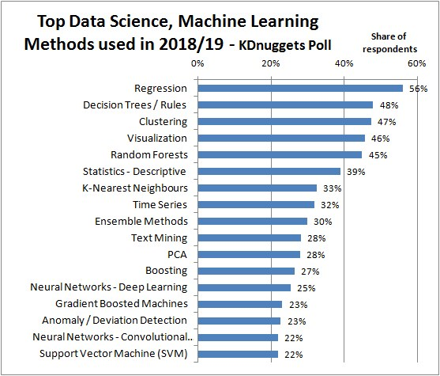
https://images.app.goo.gl/RZL5fApQc5t4syyr5

Slide 46
AI Model and Popular Application
Classifier (Supervised) – Machine Learning
Regression (Financial or Economic Prediction)
Decision Tree (Operation Research)
Random Forest (Operation Research)
XG-Boost (Operation Research)
SVM (Text, Handwriting and Biology Classification)
Naïve Bayesian (Document classification, Word Frequency)
Genetic Algorithm (Solar Collector, Antenna Location)
Multi-Layer Perceptron (General Classification)

Slide 47
AI Model – Deep Learning Model and Popular Application
Hidden Markov (Speech and Handwriting Recognition)
Recurrent Neural Network (Speech and Handwriting plus Time Series Analysis)
Long Short Term Memory (Same as RNN)
Generative Adversarial Network (Fashion, Art, Game)
Convolution Neural Network (Picture Recognition)

Slide 48
AI Model
Clustering (Unsupervised)
K-Means (Market Segmentation) – KNN classifier
Gaussian Mixture Model (Market Segmentation)
Others Technologies
Reinforcement Learning (Robot, Autonomous Vehicle)
Auto-Encoder (Reduce dimension for Picture)
Kernel Density Estimator (Advance Data Wrangling technique to reduce outlier and noise)
Block Chain (Transaction base application like trading of share)
Robotic Process Automation (Automation)
Chatbot (Automation)

Slide 49
AI Model – Feature Selection
Manifold Learning (Similar to PCA)
Correlation Coefficient

Slide 50
AI & Machine Learning

Slide 51
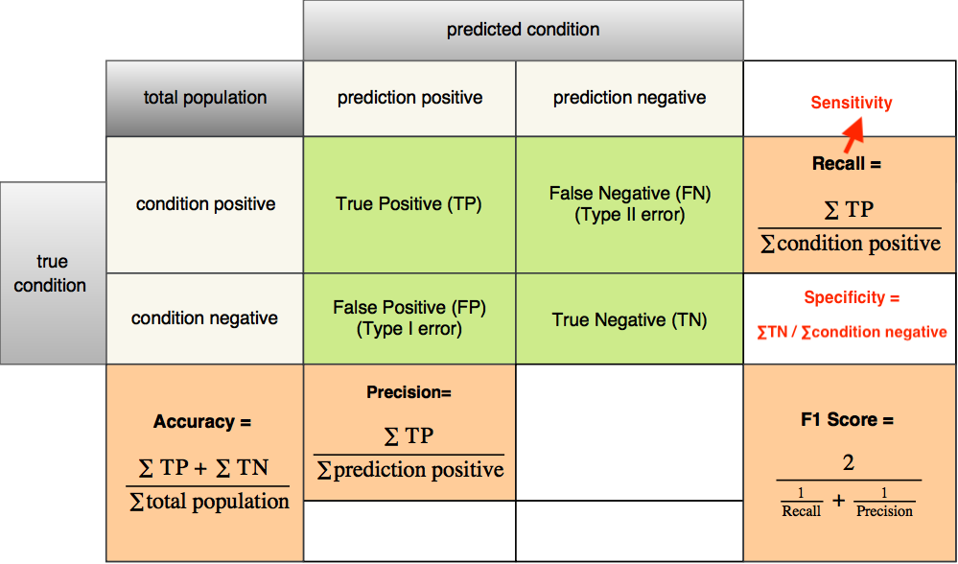
Accuracy
https://images.app.goo.gl/yGHjQrE27emHFTRd7

Slide 52
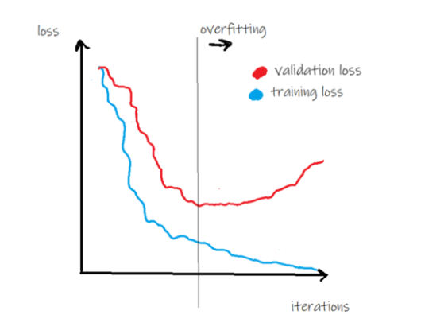
Generalization & Regularization & Overfitting
https://towardsdatascience.com/generalization-regularization-overfitting-bias-and-variance-in-machine-learning-aa942886b870

Slide 53
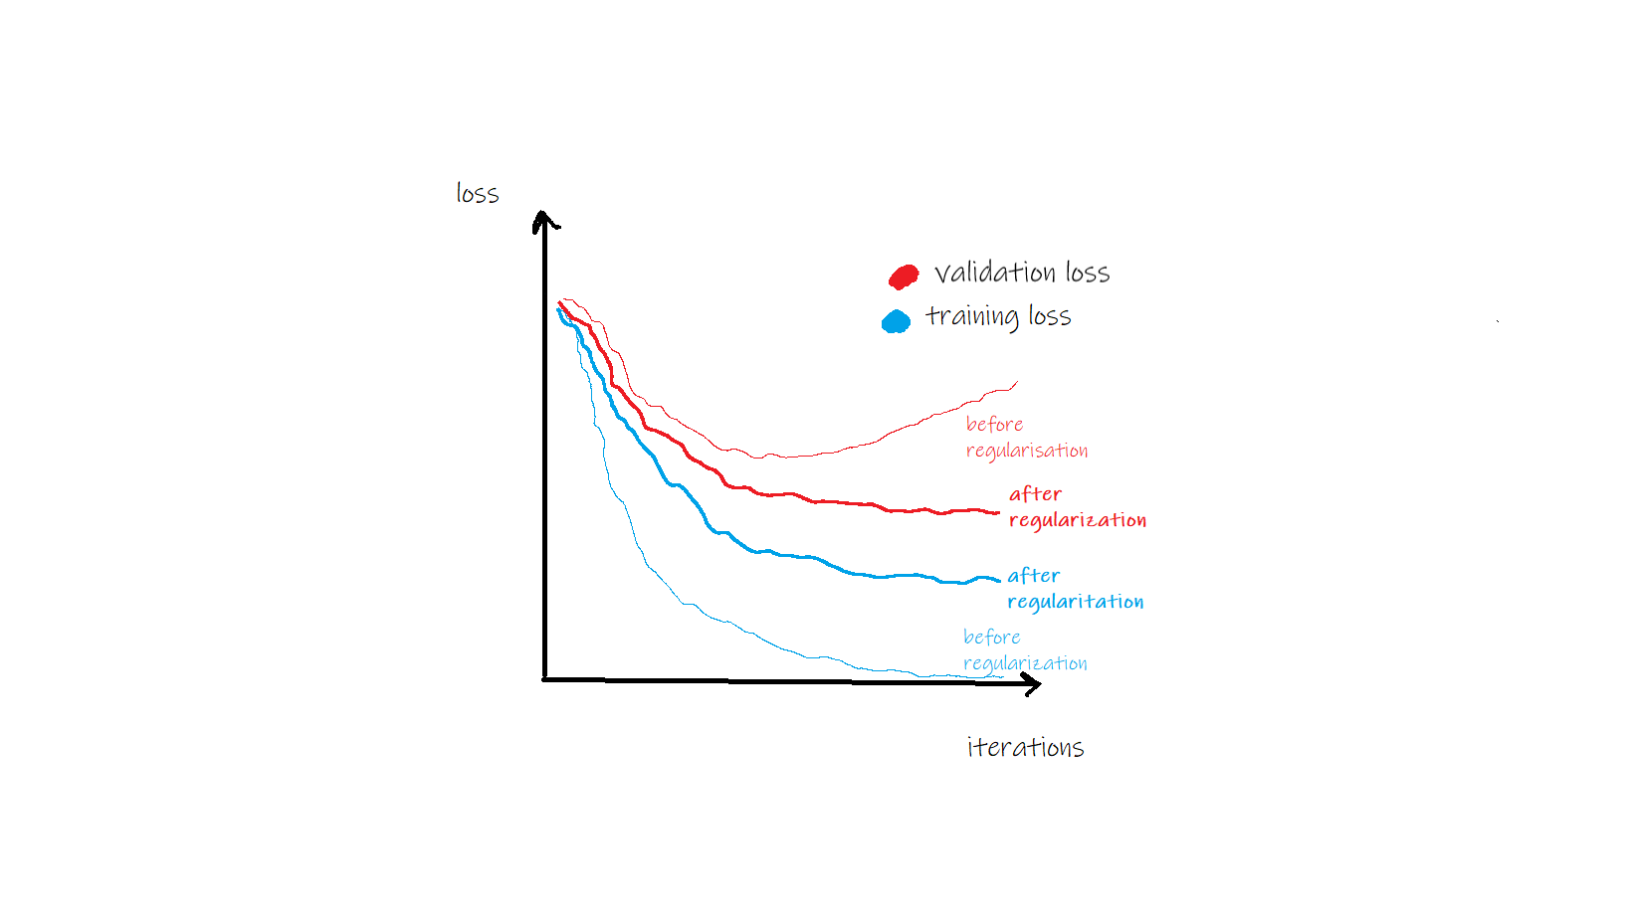
Generalization & Regularization
https://towardsdatascience.com/generalization-regularization-overfitting-bias-and-variance-in-machine-learning-aa942886b870

Slide 54
Generalization & Regularization Method
Bagging
Dropout
Learning Rate
Cross Validation (n-fold, n-cross)
Early Stopping

Slide 55
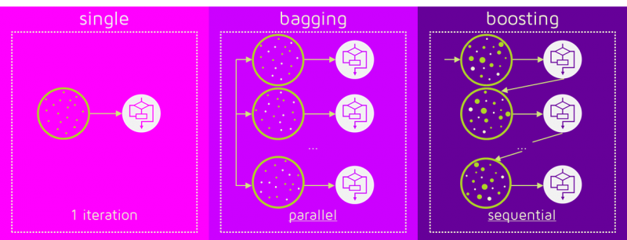
Bagging (Random Forest) & Boosting (XGBoost)
https://images.app.goo.gl/QsNjBambxZRSxyYF9

Slide 56
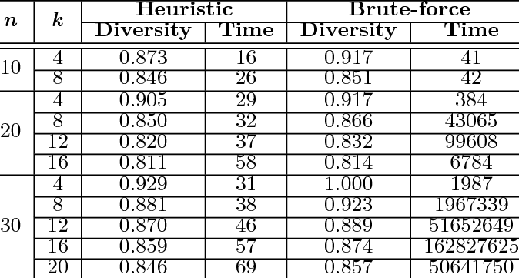
Heuristic vs Brute-force
https://www.researchgate.net/publication/220796171_Preference-aware_publishsubscribe_delivery_with_diversity#pf9

Slide 57
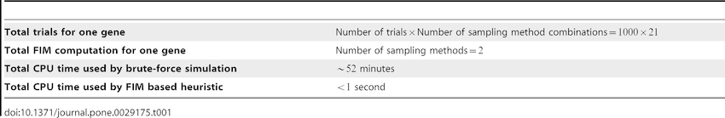
Heuristic vs Brute-force

Slide 58
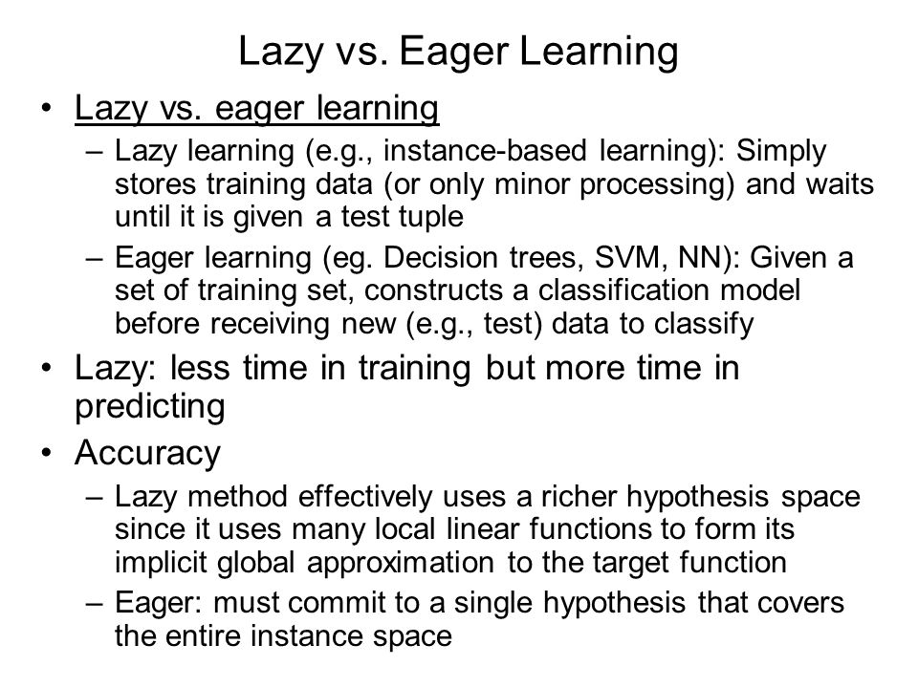
https://images.app.goo.gl/q9aHwvKF6EYhfueQ8

Slide 59
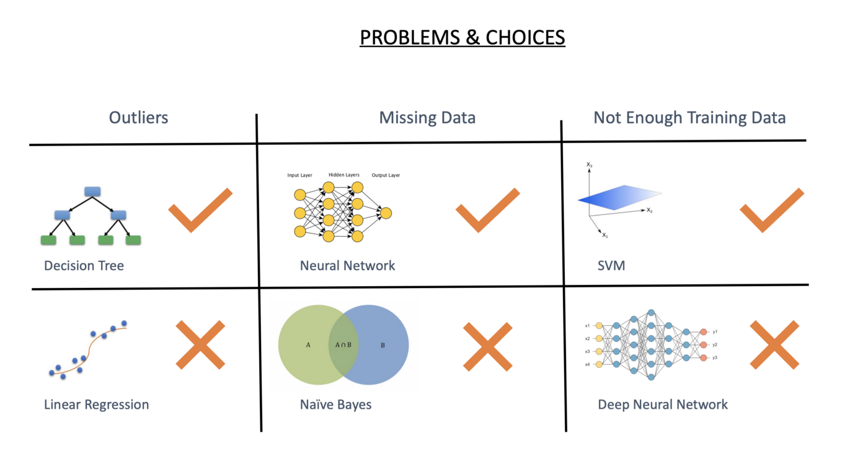
Regression, Decision Tree and Neural Network
https://images.app.goo.gl/8Ki5yN1bFvVCK2AZ8

Slide 60
Regression, Decision Tree and Neural Network
Structured Data
Regression – Nice pattern, can apply heuristic
Decision Tree – You can expand the tree until 100% accuracy during training, over fitting problem. Usually XGBoost can perform best for structured data
Unstructured Data
Neural Network

Slide 61
Software
R
R Studio
R Studio Cloud
Python
Pycharm
Anaconda – Jupyter, Spider
Google Colab
WEKA (SAS)
EXCEL PLUGIN

Slide 62
Software Needed
Excel Data Analytics https://support.office.com/en-us/article/load-the-analysis-toolpak-in-excel-6a63e598-cd6d-42e3-9317-6b40ba1a66b4
Weka https://www.cs.waikato.ac.nz/ml/weka/downloading.html
R Studio https://www.rstudio.com/products/rstudio/download/
PyCharm https://www.jetbrains.com/pycharm/download/#section=windows
Python https://www.python.org/downloads/
R https://www.r-project.org/
R Library RCPP : https://www.dropbox.com/s/b04ty31ka6gvgoh/Rcpp_0.12.16.zip?dl=0
ANACONDA : https://www.anaconda.com/distribution/
WEKA : https://www.cs.waikato.ac.nz/ml/weka/downloading.html

Slide 63

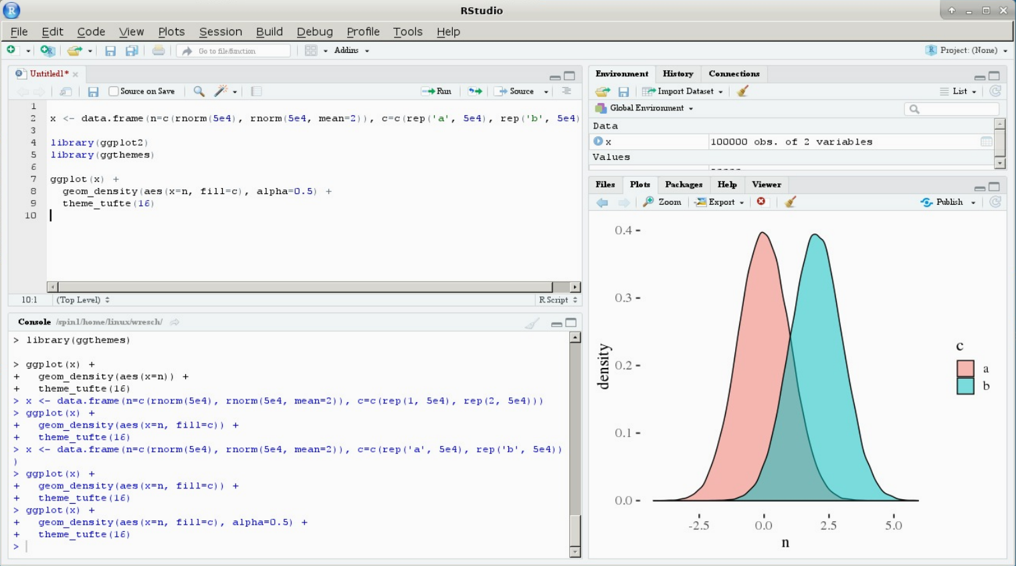
Software
R (R Foundation)
RStudio (RStudio Inc) is an integrated development environment (IDE) for R

Slide 64

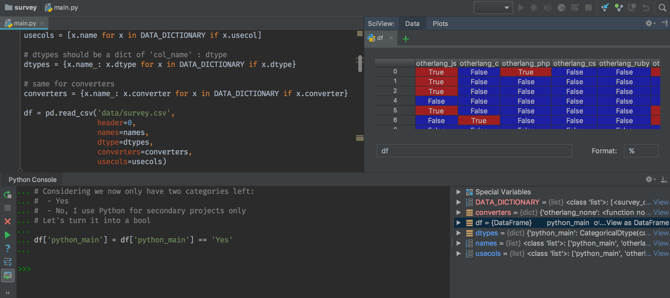
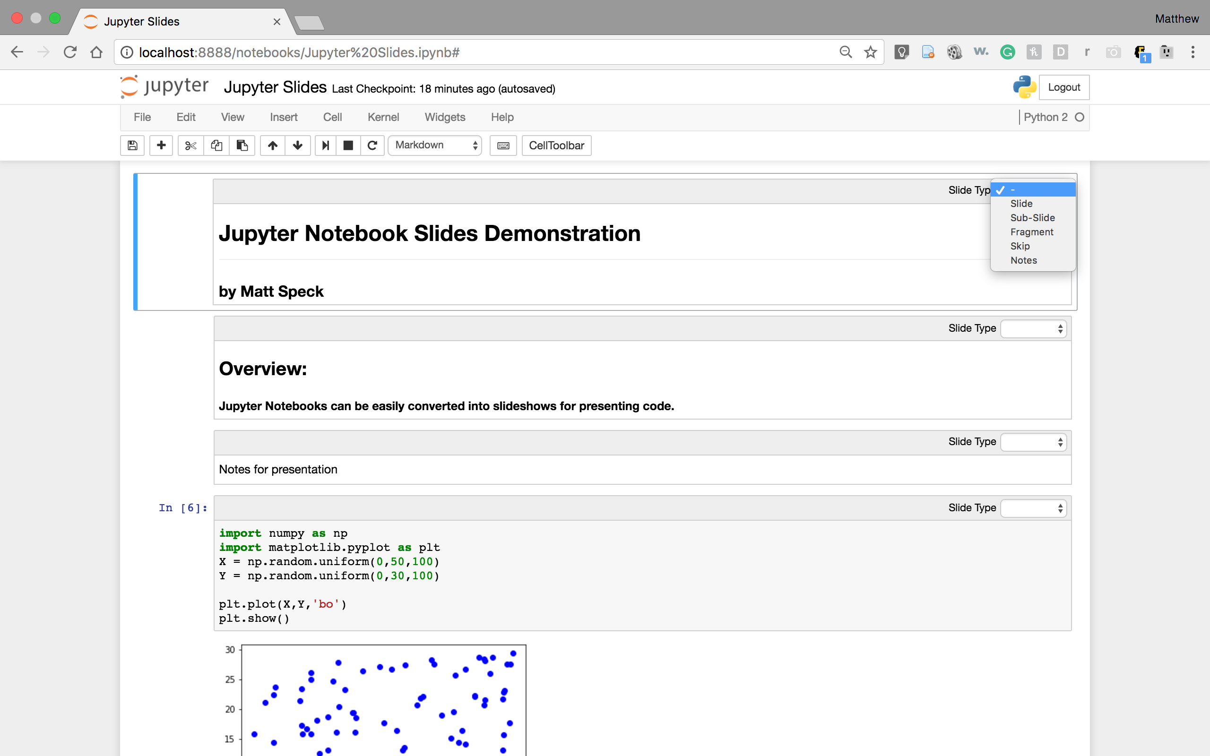
Python, PyCharm, Anaconda, Jupyter
Python (Python Foundation)
PyCharm (IDE) - JetBrains
Anaconda & Jupyter (IDE) – (Anaconda Inc) 1500 packages

Slide 65
Noncoding Tools
Weka (AI)
Waikato Environment for Knowledge Analysis (Weka), developed at the University of Waikato, New Zealand.
Data preprocessing, clustering, classification, regression, visualization, and feature selection
Excel Plugin (Data Analytics)

Slide 66
Libraries & Packages
Tensor Flow
Keras

Slide 67
Student’s Successful Projects
RPA
Chatbot
Dashboard
Prediction

Slide 68
Activity 1
Install R, R Studio, Python, Pycharm, Anaconda, Weka, Google Colab, R Studio online

Slide 69
Activity 2
Form your group

Slide 70
Class Participation : “To know you better” (Due Date: one day before your next class 2359) 2% 26 Aug 2359
Write an essay to answer a few questions below (about 100 words):
What are the knowledge you wish to learn from BC3409?
What are the top 2 jobs that you wish to work as? (Example: Data Scientist)

Slide 71
What have you learnt?
AI Models
AI Tools

Slide 72
Homework and Reading Material (Optional)
Shwartz Chapter
https://www.dropbox.com/s/ed9s6zyrtjgc7dk/Shwartz.pdf?dl=0
Video
https://www.youtube.com/watch?v=_3eaVy8c-xk
https://www.youtube.com/watch?v=ggIk08PNcBo
Homework (Interview Questions)
https://www.edureka.co/blog/interview-questions/artificial-intelligence-interview-questions/

Slide 73
Remember: 2% to Know you better

Slide 74
Thank You

Slide 75
Optional
Regression Review
Decision Tree Review

